Slide 1

INTELLI DOMOTICS
CB.SC.U4AIE24103- Ananya
CB.SC.U4AIE24119- Kiranmai
CB.SC.U4AIE24120- Sudeshna
CB.SC.U4AIE24163- Devi Sri

Slide 2
Smart homes integrate AI and IoT to improve efficiency, security, and convenience. Intelli Domotics leverages these technologies to automate tasks, optimize energy use, and enhance safety.
With AI-driven intelligence and IoT connectivity, Intelli Domotics provides an efficient, scalable, and cost-effective smart home solution
INTRODUCTION

Slide 3
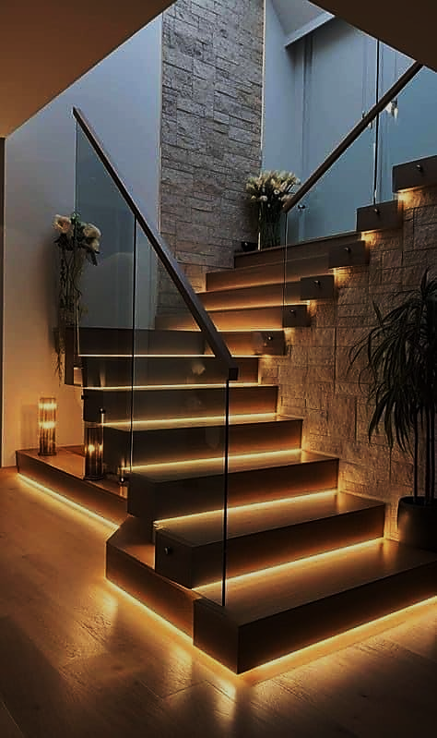
To develop an AI-driven smart home automation system using ESP-32.
To implement priority-based automation for energy-efficient control.
To integrate real-time learning to adjust device scheduling dynamically.
To enhance security using AI-enabled authentication and threat detection.
To provide remote monitoring and control via IoT.
To implement AI-based predictive analytics for better energy utilization.
OBJECTIVES

Slide 4

METHODOLOGY

Slide 5
Garage
Vehicle Detection
  Sensor: IR Sensor Module
  Function: Detects vehicles entering the garage.
  Automation Rule:
    If a vehicle is detected, automatically open the garage door.
Obstacle Safety
  Sensor: Additional IR Sensor
  Function: Detects obstacles when the shutter is closing.
  Automation Rule:
    If an obstacle is detected, halt the shutter to prevent damage.
Relay Module Control
  Function: Controls the shutter motor and lights.
  Automation Rule:
    Turn on garage lights when motion is detected.
    Automatically open/close the shutter based on vehicle detection and obstacle clearance.

Slide 6
ROOM-1
Object Detection
  Sensor: PIR Motion Sensor
  Function: Detects motion to automate door operations.
  Automation Rule:
    If motion is detected near the door, open the door automatically.
Light Control
  Sensor: LDR Sensor
  Function: Manages lighting based on ambient light levels.
  Automation Rule:
    If ambient light is low and motion is detected, turn on the light.
    If sufficient light is detected or no motion occurs, turn off the light

Slide 7
ROOM-2
1. Fan Speed Control
Manual Control: Potentiometer for manual adjustment.
Automatic Control: DHT11 sensor monitors temperature and humidity.
  Automation Rule:
    If temperature exceeds a defined threshold, increase fan speed automatically.
    If the temperature is low, reduce the fan speed.
    Allow manual speed adjustment through the potentiometer as an override.

Slide 8
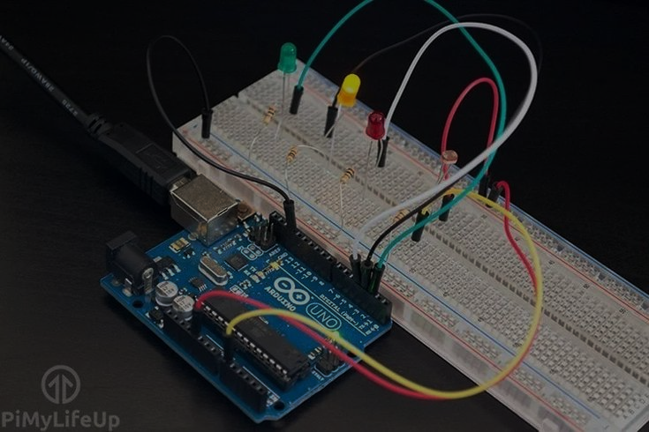
Component | VCC Connection | GND Connection | Signal/Data Pin | Relay IN Pin | Device Controlled | Notes
IR sensor 1 | Arduino 5V | Arduino GND | Digital Pin 2 | Relay IN1(Pin 4) | Garage Motor(Shutter) | Trigger motor to open the shutter
IR Sensor 2 (Obstacle) | Arduino 5V | Arduino GND | Digital Pin 3 | Relay IN2 (Pin 5) | Garage Light | Detect obstacles and turn on light
2-Channel Relay (Garage | Arduino 5V | Arduino GND | - | Pin 4 (Motor), 5 (Light) | Garage Motor & Light | Common and NO connected to devices
PIR Motion Sensor | Arduino 5V | Arduino GND | Digital Pin 6 | Relay IN (Pin 7) | Room 1 Light | Turns light on upon detecting motion
LDR Sensor (Voltage Divider) | Arduino 3.3V | Arduino GND (via 10kΩ resistor) | Analog Pin A0 | Relay IN (Pin 7) | Room 1 Light | Automatic light management
1-Channel Relay (Room Light) | Arduino 5V | Arduino GND | - | Pin 7 | Room 1 Light | Controlled by PIR and LDR sensors
DHT11 Temperature Sensor | Arduino 3.3V | Arduino GND | Digital Pin 8 | - | - | Measures temperature

Slide 9
Overall work Flow
Webpage Setup:
  Users can add devices, assign pins, and set automation rules for each room/area.
Java Backend:
  Automatically fetches and processes rules based on real-time sensor data.
  Executes device actions following the priority queue for efficient management.
Arduino & Flask Backend:
  Arduino sends sensor data to Flask.
  Flask communicates with Java for rule execution and sends control signals to Arduino.
Real-Time Updates:
  Webpage dynamically displays device status and updates in real-time.

